Slide 1
JCF41
JavaFx Collections
TableView & TreeView

Slide 2
JavaFx Collections
Extension of the Java Collection Framework, defined in javaFx.collections package
    ObservableList
    ListChangeListener
    ObservableMap
    MapChangeListener
    ObservableSet
    SetChangeListener
observable
Collection
TreeView
TreeChange
Listener
* listeners
Change
Listener

Slide 3
ObservableMap
Provide a Map that supports Observability
      Extends from javaFx.beans.Observable & java.util.Map
Adding or removing the appropriate listeners
Has methods to manipulate the collection elements
diamond
operator
Map<String, Integer> map= new HashMap<>();
ObservableMap<String, Integer> observableMap =
FXCollections.observableMap(map);
observableMap.addListener(new MapChangeListener() {
@Override
public void onChanged(MapChangeListener.Change change) {
System.out.println("Detected a change! ");
}});
Notes:
Diamond Operator: redundant type arguments in new argument (JDK7)

Slide 4
Example ObservableList
//Use java collection to create the list
List<String> list = new ArrayList<String>();
// Now add observability by wrapping it with ObservableList
ObservableList<String> observableList =
FXCollections.observableList(list);
observableList.addListener(new ListChangeListener() {
@Override
public void onChanged(ListChangeListener.Change change) {
System.out.println("Detected a change! ");
}
});
observableList.add("item one");
list.add("item two");
System.out.println("Size: "+ observableList.size());
output ?
Notes:
// Changes to the observableList WILL be reported.
// This line will print out "Detected a change!"
observableList.add("item one");
// Changes to the underlying list will NOT be reported
// Nothing will be printed as a result of the next line.
list.add("item two");

Slide 5
Listeners using Lambda
Lambda expressions a new feature in Java SE 8
Way of represent one method interface using an expression
Because Listener has a single method onChanged the lambda expression must be an implementation of the onChanged method.
observableList.addListener(new ListChangeListener() {
@Override
public void onChanged(ListChangeListener.Change change) {
System.out.println("Detected a change! ");
}});
observableList.addListener((ListChangeListener c) -> {System.out.println("Detected a change! });

Slide 6
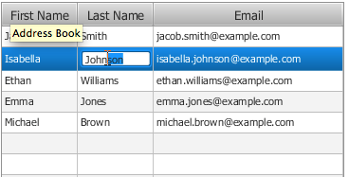
Tables in JavaFx
Designed to represent data in tabular form:
    Column reordering by user
    Multiple column sorting
    Width resizing
    Cell factories for customizing cell content

Slide 7
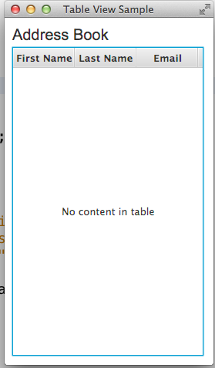
Create a Table
TableView and TableColumn are the minimum classes required to create a table
TableColumn
TableCell
TableView
private TableView<Person> table = new TableView<Person>();
TableColumn firstNameCol = new TableColumn("First Name");
TableColumn lastNameCol = new TableColumn("Last Name");
TableColumn emailCol = new TableColumn("Email");
table.getColumns().addAll(firstNameCol, lastNameCol, emailCol);

Slide 8
Data Model (1)
Populate a table by implementing the data model and by applying a cell factory:
    Step 1: Defining the Data model
    Step 2: Defining Table Data in an ObserverList
    Step 3: Setting Data Properties to table columns
Step 1: Defining the Data Model
public static class Person {
private final SimpleStringProperty firstName;
private final SimpleStringProperty lastName;
private final SimpleStringProperty email;
private Person(String fName, String lName, String email) {
this.firstName = new SimpleStringProperty(fName);
this.lastName = new SimpleStringProperty(lName);
this.email = new SimpleStringProperty(email);
}
Notes:
SimpleStringProperty: used to generate getters/setters

Slide 9
DataModel (2)
Step 2: Associate the Data Properties to the Table Columns
TableColumn firstNameCol = new TableColumn("First Name");
firstNameCol.setCellValueFactory(
new PropertyValueFactory<Person, String>("firstName"));
Step 3: Defining Table Data in an ObservableList (add data to TableView)
private final ObservableList<Person> data =
FXCollections.observableArrayList(
new Person("Jacob", "Smith", "jacob.smith@example.com"),
new Person("Ethan", "Williams", ethan.williams@example.com));
Table.setItems(data);
Notes:
The setCellValueFactory method specifies a cell factory for each column. The cell factories are implemented by using the PropertyValueFactory class, which uses the firstName, lastName, and email properties of the table columns as references to the corresponding methods of the Person class.

Slide 10
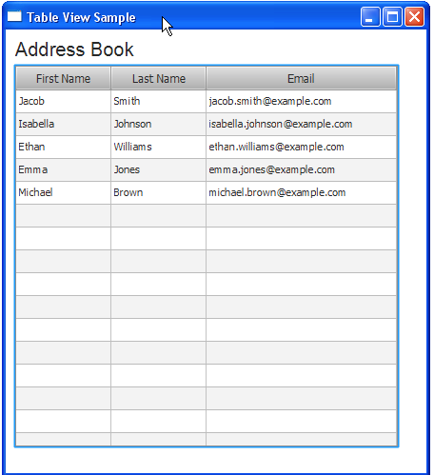
TableView & Datamodel
The cell factories are implemented by using the PropertyValueFactory class, which uses properties of the table columns as references to the corresponding methods of the Person class
Because the ObserverList enables the tracking of changes, the TableView content is automatically updated whenever the data changes

Slide 11
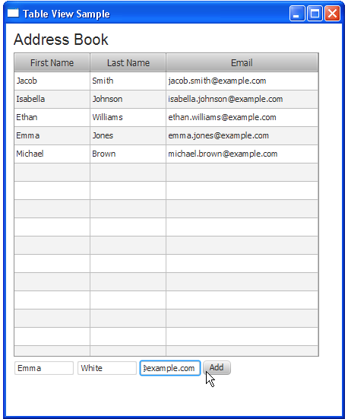
Adding new rows
final TextField addFirstName = new TextField();
addFirstName.setPromptText("First Name");
addFirstName.setMaxWidth(firstNameCol.getPrefWidth());
final Button addButton = new Button("Add");
addButton.setOnAction(new EventHandler<ActionEvent>() {
@Override
public void handle(ActionEvent e) {
data.add(new Person(
addFirstName.getText(),
addLastName.getText(),
addEmail.getText()));
addFirstName.clear();
addLastName.clear();
addEmail.clear();
}
});

Slide 12
How a Table Cell is Rendered
Cell Factory
To specialize the cell used for the TableView, you must provide an implementation of the CellFactory callback function on the TableView
The implementation of the cell factory is responsible for creating a cell instance and also configuring that cell so that it reacts to changes in its state
emailCol.setCellFactory(new Callback<TableColumn<Person, String>, TableColumn<Person, String>>() {
@Override
public TableColumn<Person, String>
call(TableColumn<Person, String> param) {
return new TableCell(Person, String)(){
@Override
protected void updateItem(String item, boolean empty){
super.updateItem(item, empty);
setTextFill(Color.Red);
setText(item);
}
Notes:
Cell Value Factory : it is like a "toString()" of only part of the row item for that related cell.
Cell Factory : it is a renderer of the cell from the cell item. Default behavior is setText(cell.item.toString()) if the cell item is not a Node, setGraphic((Node)cell.item) otherwise. Set this property if the cell is supposed to support editing OR if you want more graphics (controls) other than default Label.

Slide 13
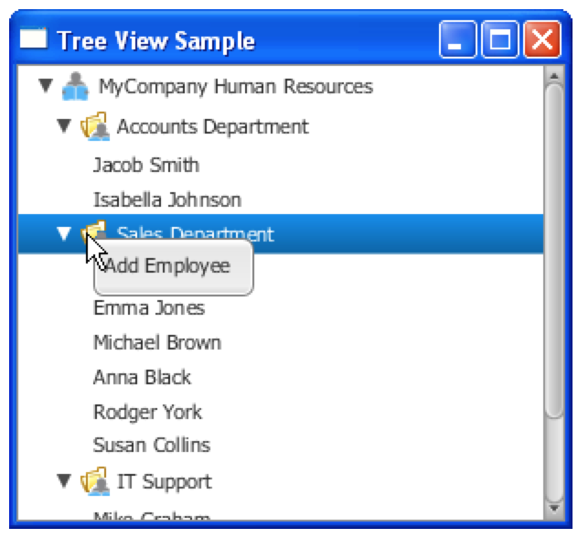
Trees in JavaFx
Provides a view of hierarchical structures
Can dynamically populate as tree is expanded
Default cell renderer can display String
For other object types create custom cell factory

Slide 14

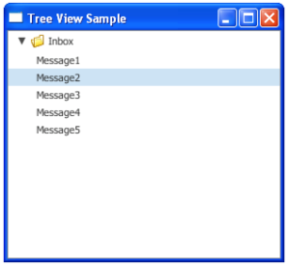
Create a Tree
TreeView and TreeItem the minimum classes required to create a table
TreeItem
Root
Child
TreeView
Leaf
private TableView<TreeItem<String> rootItem =
new TreeItem<String> ("Inbox", rootIcon); rootItem.setExpanded(true);
for (int i = 1; i < 6; i++) {
TreeItem<String> item = new TreeItem<String> ("Message" + i); rootItem.getChildren().add(item)
}
TreeView<String> tree = new TreeView<String> (rootItem); ;

Slide 15
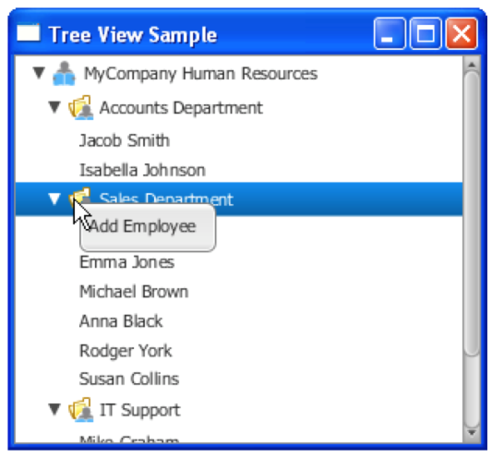
Create a Tree
TreeItem<String> rootNode =
new TreeItem<String>("MyCompany Human Resources", rootIcon);
for (Employee employee : employees) {
TreeItem<String> empLeaf = new TreeItem<String>(employee.getName());
boolean found = false;
for (TreeItem<String> depNode : rootNode.getChildren()) {
if (depNode.getValue().contentEquals(employee.getDepartment())){
depNode.getChildren().add(empLeaf);
found = true;
break;
}
}
if (!found) {
TreeItem<String> depNode = new TreeItem<String>(
employee.getDepartment(),
new ImageView(depIcon)
);
rootNode.getChildren().add(depNode);
depNode.getChildren().add(empLeaf);
}
}
Notes:
Automatisch Employee aan juiste department toevoegen, als department niet bestaat: ook eerst department aanmaken

Slide 16
Cell Factory / Cell Factories
treeView.setEditable(true);
treeView.setCellFactory(new Callback<TreeView<String>,
TreeCell<String>>(){
@Override
public TreeCell<String> call(TreeView<String> p) {
return new TextFieldTreeCellImpl();
}
});
private final class TextFieldTreeCellImpl extends TreeCell<String> {
private TextField textField;
public TextFieldTreeCellImpl() {}
@Override
public void updateItem(String item, boolean empty) {
super.updateItem(item, empty);
// to do
Notes:
Cell Factory : it is a renderer of the cell from the cell item. Default behavior is setText(cell.item.toString()) if the cell item is not a Node, setGraphic((Node)cell.item) otherwise. Set this property if the cell is supposed to support editing OR if you want more graphics (controls) other than default Label.

Slide 17
Background info
JavaFx Collections:
http://docs.oracle.com/javafx/2/collections/jfxpub-collections.html
TableView:
http://docs.oracle.com/javafx/2/ui_controls/table-view.html
TreeView:
http://docs.oracle.com/javafx/2/ui_controls/tree-view.html
TreeTableView:
http://docs.oracle.com/javase/8/javafx/user-interface-tutorial/tree-table-view.html

